Slide 1


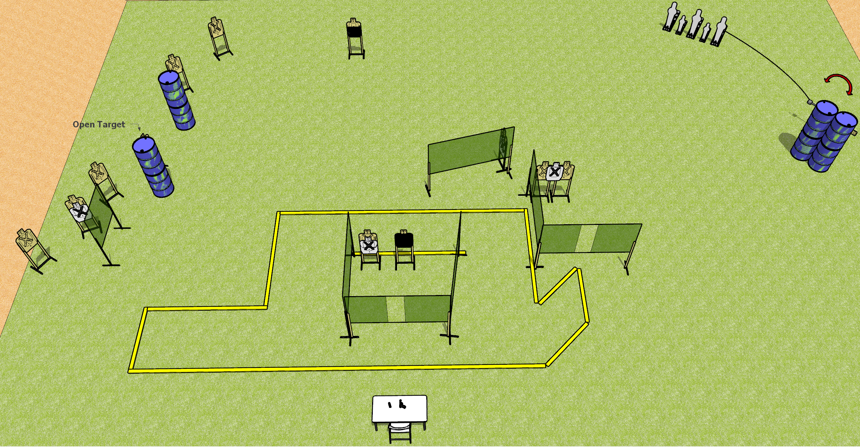
 | Dothan Gun Club – USPSA Match Don’t Shoot the Wire Course Designer : Drew Coleman
START POSITION : Seated in chair back flat against back of chair, feet flat on ground, palms flat on knees. Chair and table legs on marks (may be moved to get seated)
GUN READY CONDITION : Pistol/PCC unloaded with trigger guard on either mark, pointed downrange. First magazine to be used on stage laying down on other mark. |  | SCORING: Comstock, 31 rounds TARGETS: 13 paper, 5 Steel SCORED HITS: Best 2 on paper, steel until down START-STOP: Audible, last shot RULES:
STAGE PROCEDURE: Engage targets as they become available from within the fault lines.

